Slide 1
LAB - 05
陳培殷老師
國立成功大學 資訊工程系

Slide 2


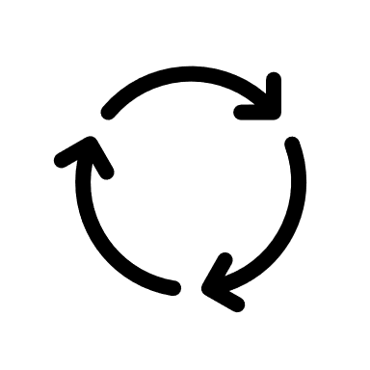
Introduction
My IC
…
DICLAB
Algorithms
HDL programming

Slide 3
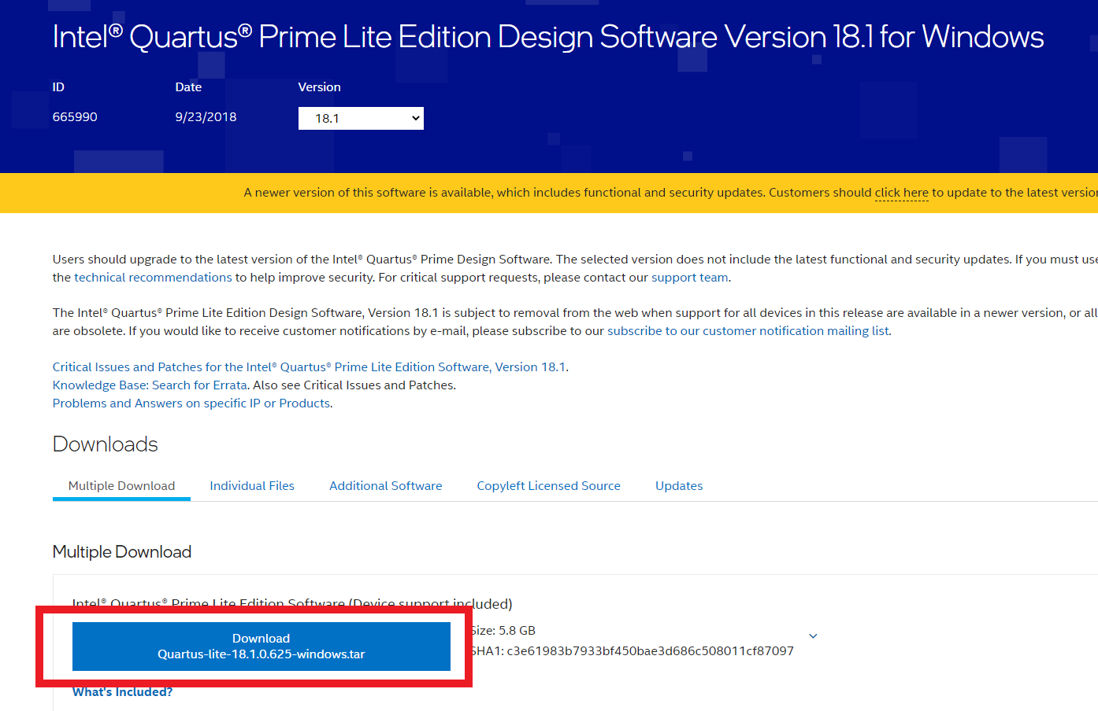
Install Quartus II
下載網址 - https://reurl.cc/eOQK7Q

Slide 4
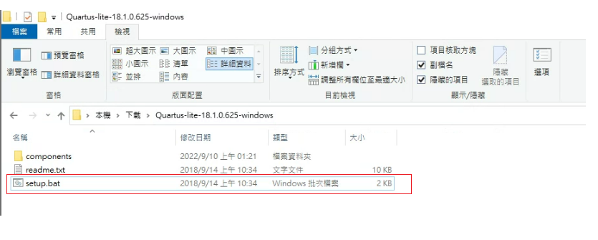
Install Quartus II
解壓縮後打開setup.bat

Slide 5
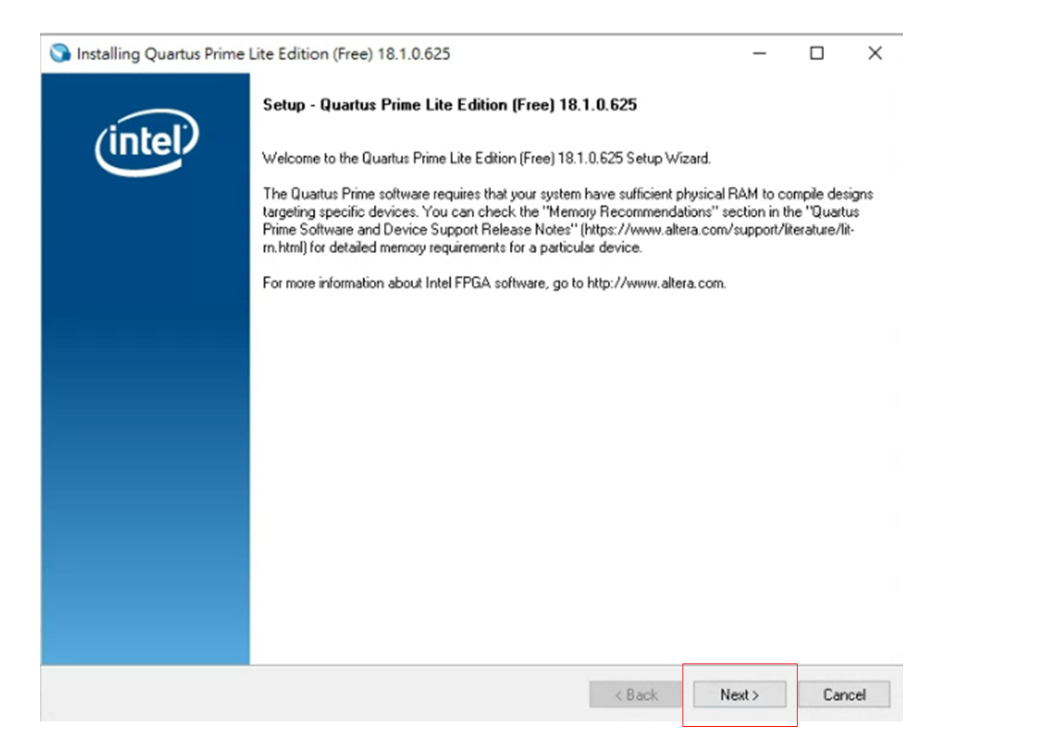
Install Quartus II
Next

Slide 6
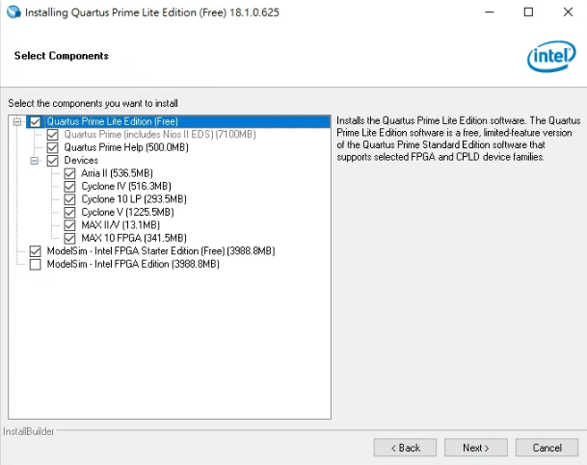
Install Quartus II
勾選選項

Slide 7
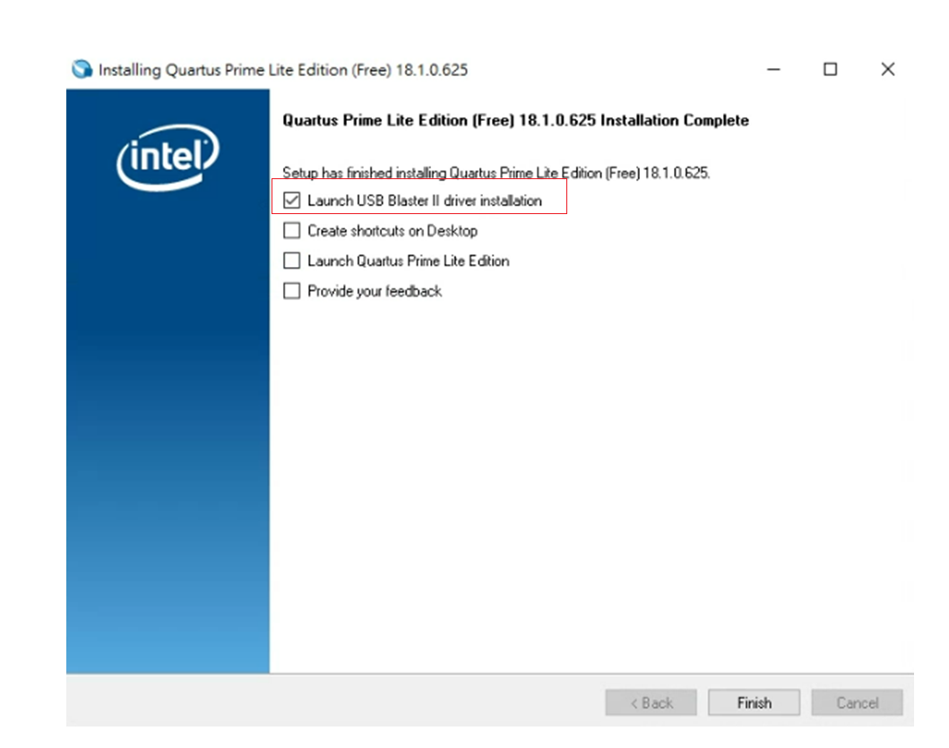
Install Quartus II
完成後勾選Launch USB Blaster II driver installation

Slide 8
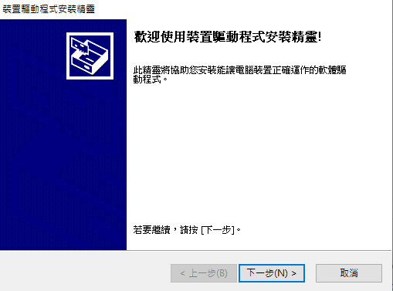
Install Quartus II
跳出裝置驅動程式安裝精靈後一直按下一步

Slide 9
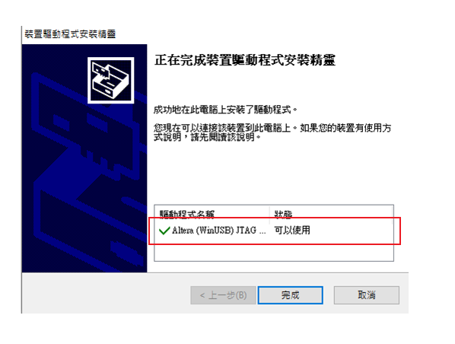
Install Quartus II
出現 “可以使用” 就完成安裝了

Slide 10
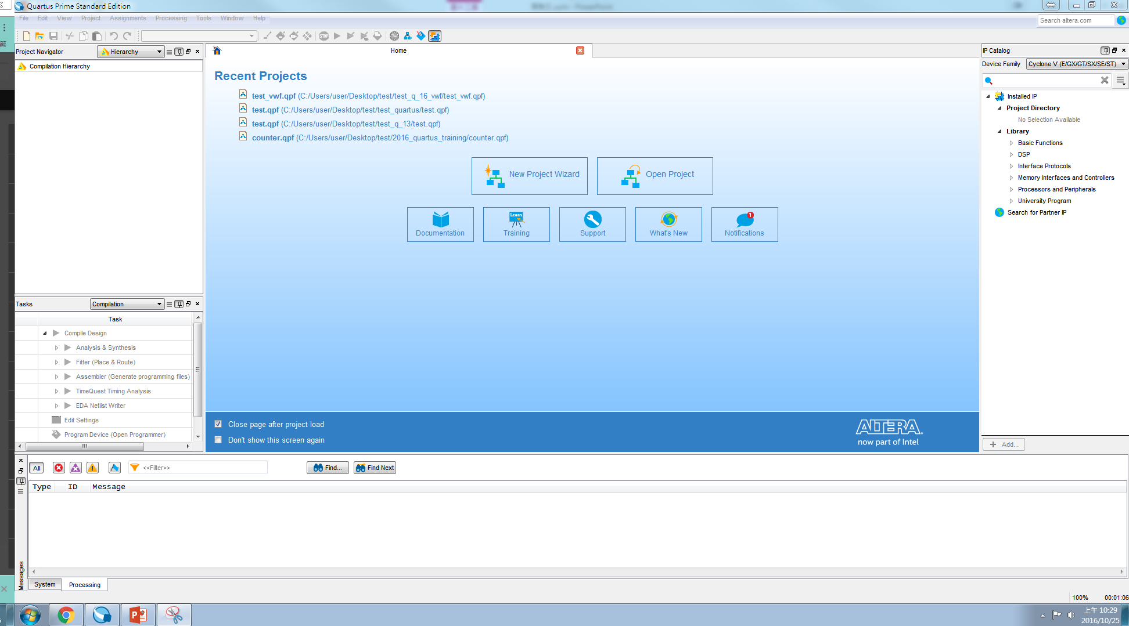
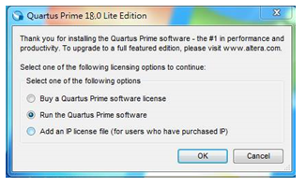
Quartus II Tutorial (1/19)
Getting Started –
Start the Quartus II software

Slide 11
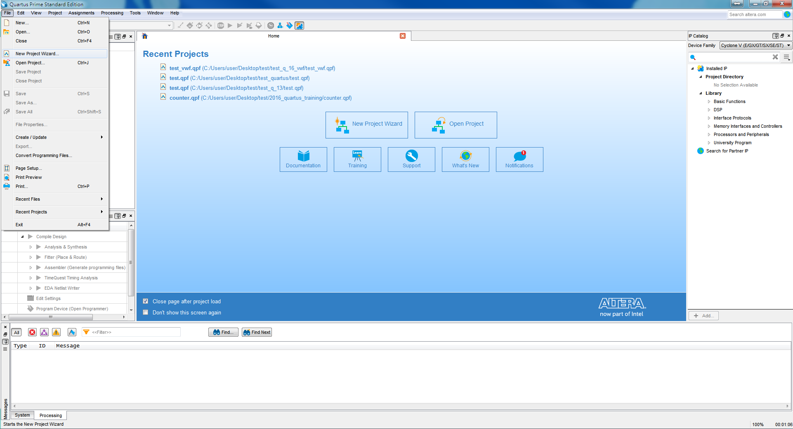
Quartus II Tutorial (2/19)
Create a New Project –
Open New Project Wizard (File → New Project Wizard…)

Slide 12
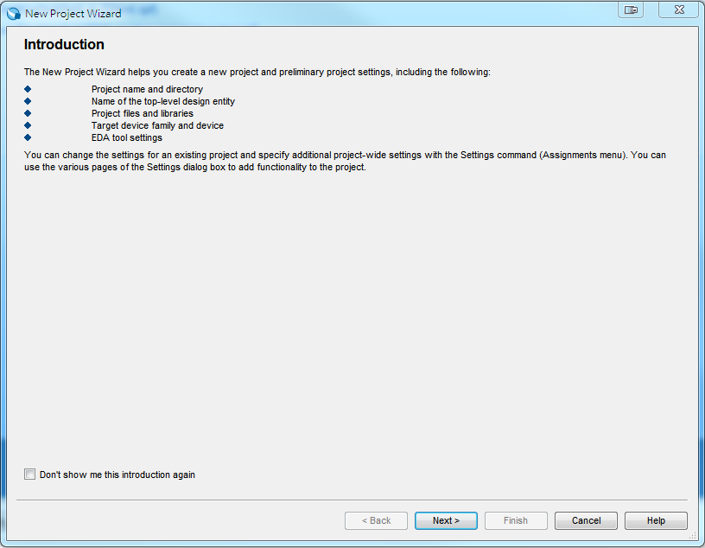
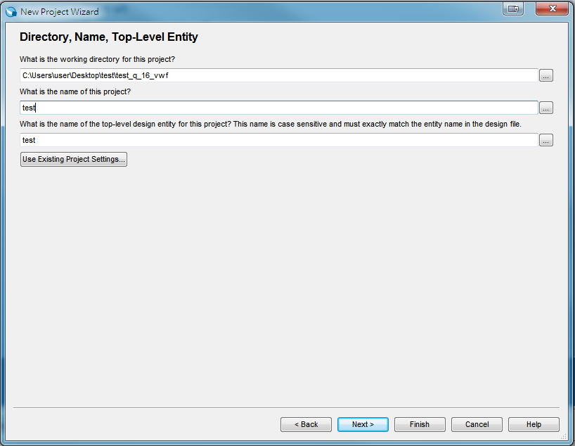
Quartus II Tutorial (3/19)
Specify the working directory and the name of the project
可先新增資料夾
請記住!名稱要相同

Slide 13
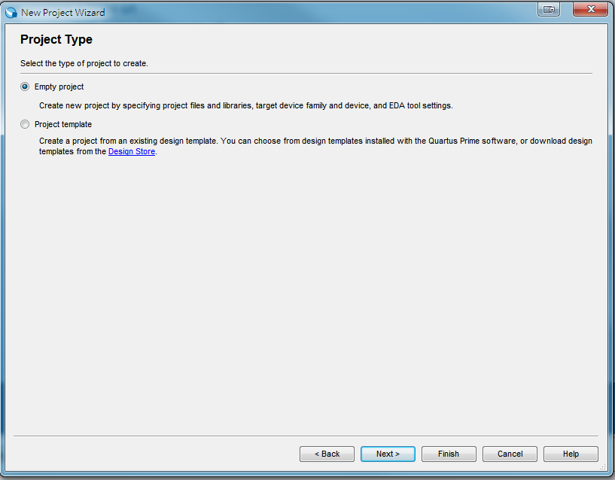
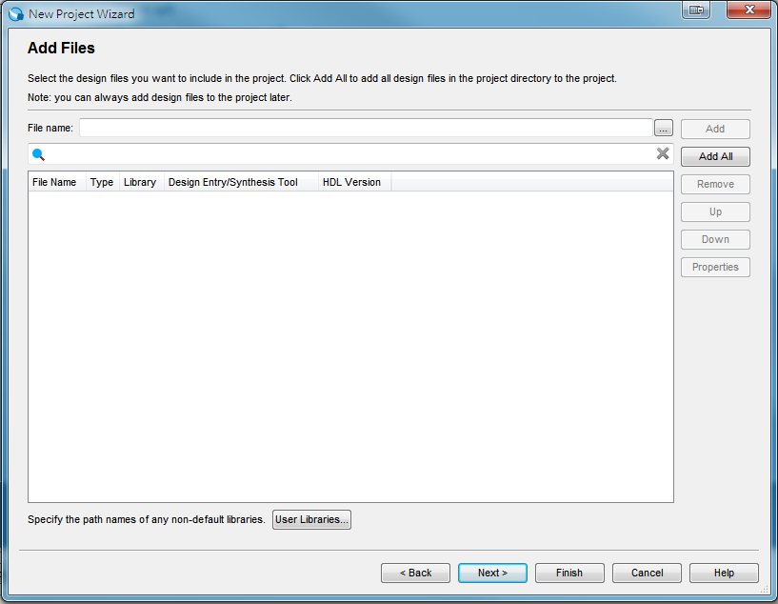
Quartus II Tutorial (4/19)
Select “Empty project”. Then, click “Next”.
Select design files. Or click “Next” to skip this step.

Slide 14
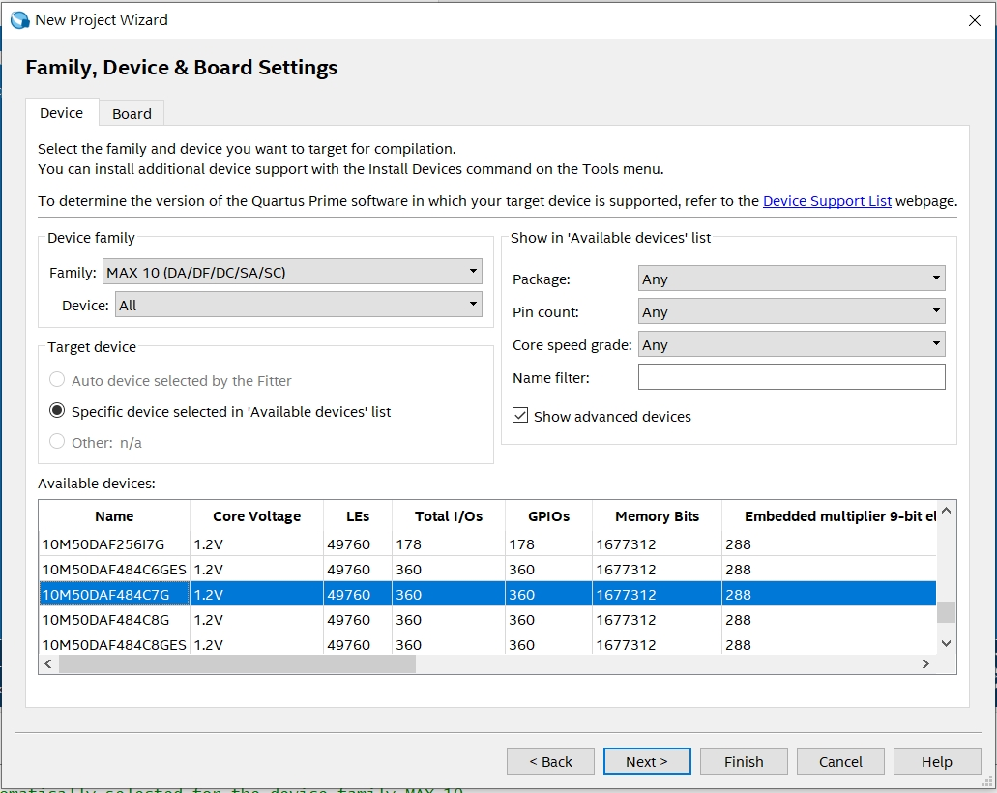
Quartus II Tutorial (5/19)
Specify device settings - (DE10-Lite Device family are used). Click “Next.”
MAX 10(DA/DF/DC/SA/SC)
10M50DAF484C7G

Slide 15
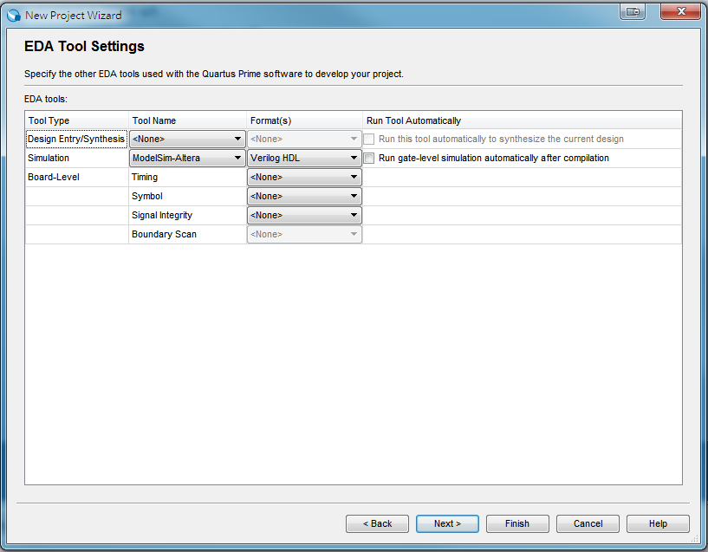
Quartus II Tutorial (6/19)
Specify EDA Tool – (Modelsim-Altera is selected for simulation). Click “Finish.”

Slide 16
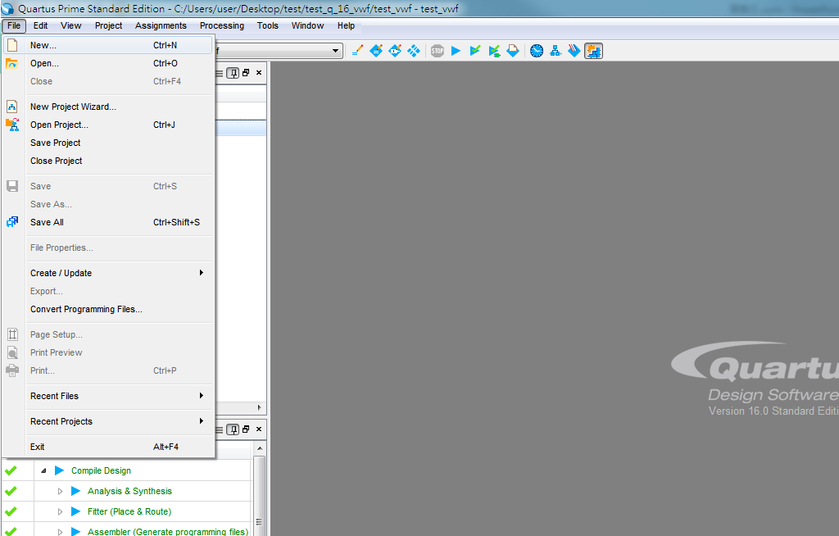
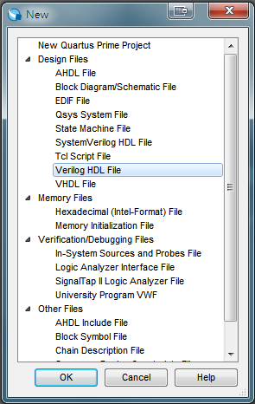
Quartus II Tutorial (7/19)
Edit a new file by opening a Verilog HDL file
(File → New → Verilog HDL File → OK)

Slide 17
Quartus II Tutorial (8/19)
Write Verilog code
Top module name 一定要跟 Project name 相同 !!
module test (
input a,
input b,
output sum,
output carry
);
/* Write your code here. */
endmodule
輸入(input) |  | 輸出(output)
被加數(a) | 加數(b) | 和(sum) | 進位(carry)
0 | 0 | 0 | 0
0 | 1 | 1 | 0
1 | 0 | 1 | 0
1 | 1 | 0 | 1

Slide 18
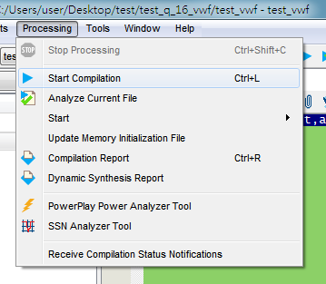
Quartus II Tutorial (9/19)
Compiling the Designed Circuit (synthesis 合成)
(Processing → Start Compilation)

Slide 19
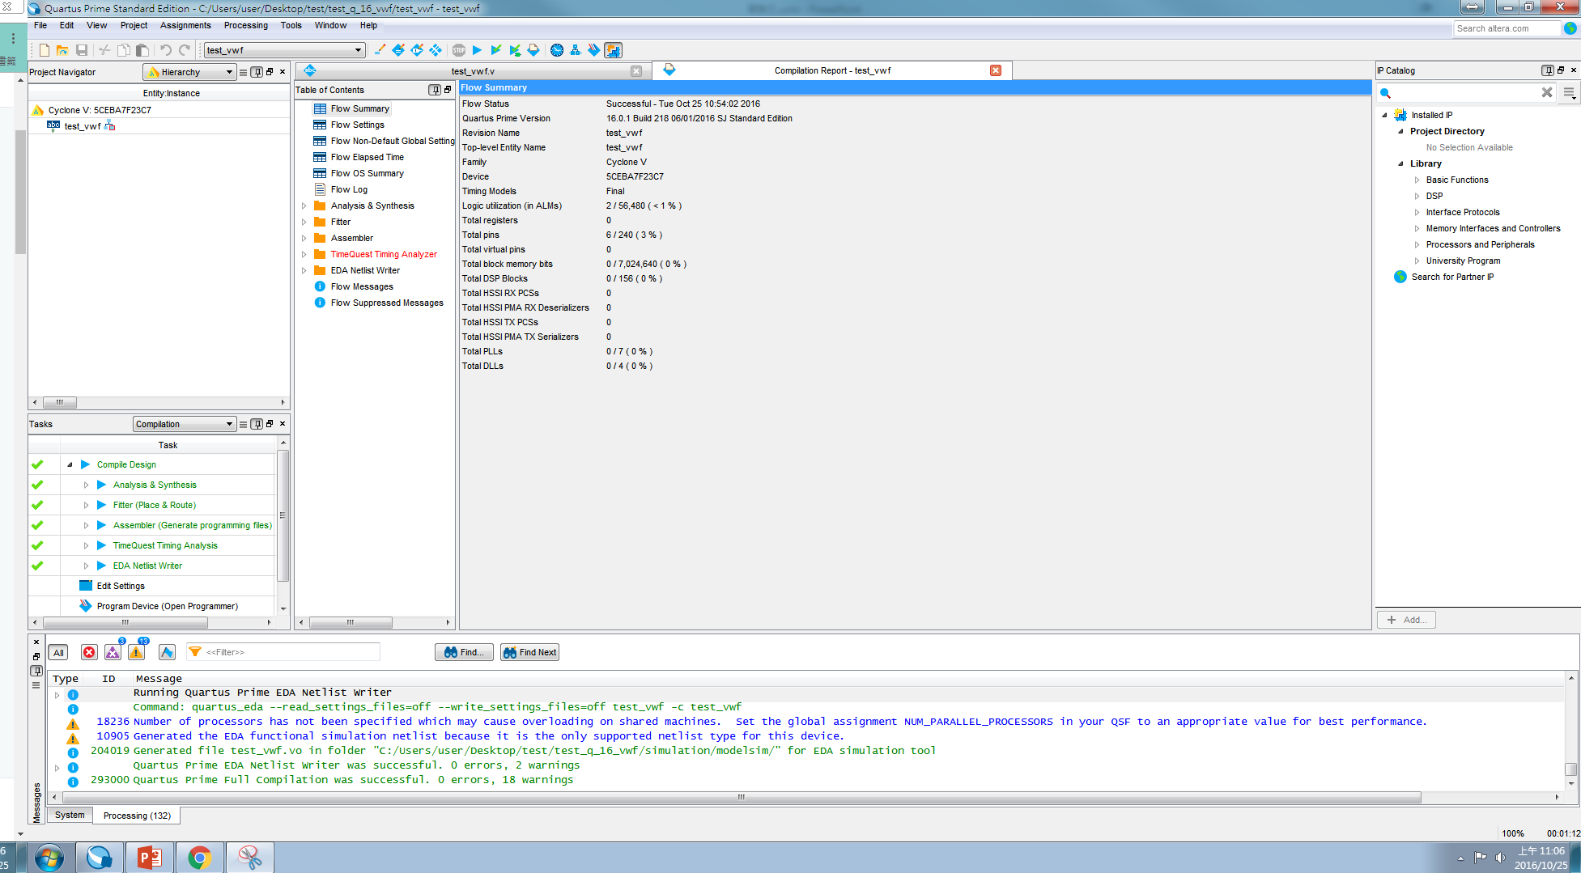
Quartus II Tutorial (10/19)
Successful compilation

Slide 20
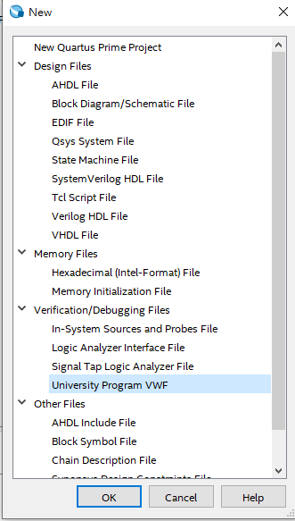
Quartus II Tutorial (11/19)
Edit a new file by opening a Verilog HDL file
(File → New → University Program VWF→ OK)
( vector waveform file )

Slide 21
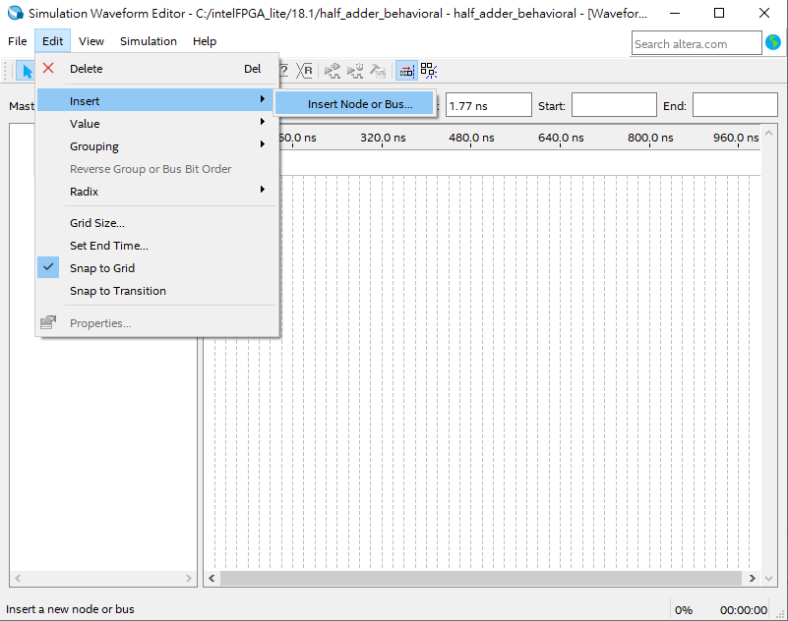
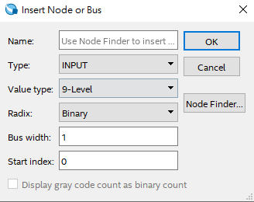
Quartus II Simulation (12/19)
Simulating the Designed Circuit
Use node finder to find all the I/O pins (Edit → Insert → Insert Node or Bus…)

Slide 22
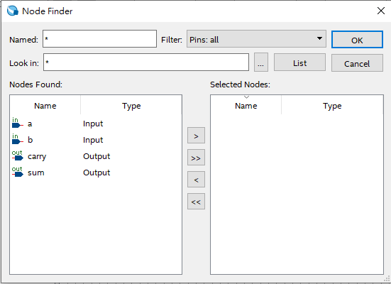
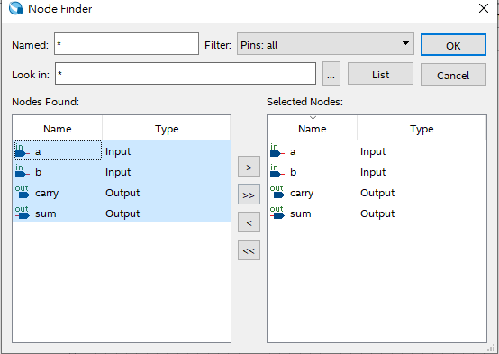
Quartus II Simulation (13/19)
Simulating the Designed Circuit
Selecting nodes to insert into the Waveform Editor
沒跑出pin腳，表示你剛剛忘記compile
全選

Slide 23
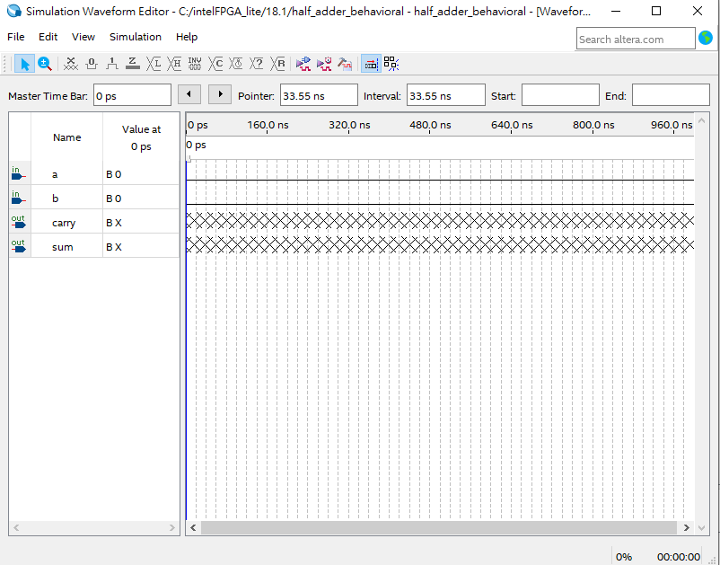
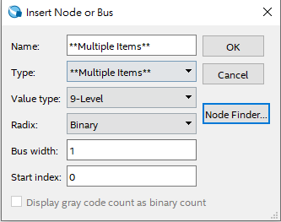
Quartus II Simulation (14/19)
Simulating the Designed Circuit
Selecting nodes to insert into the Waveform Editor

Slide 24
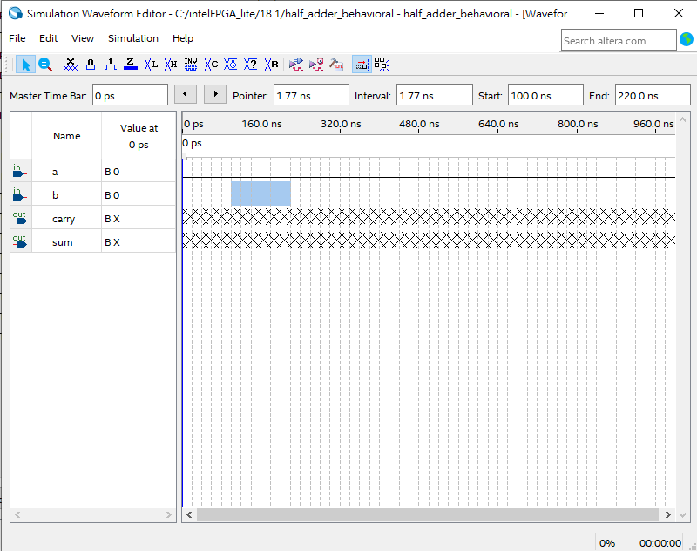
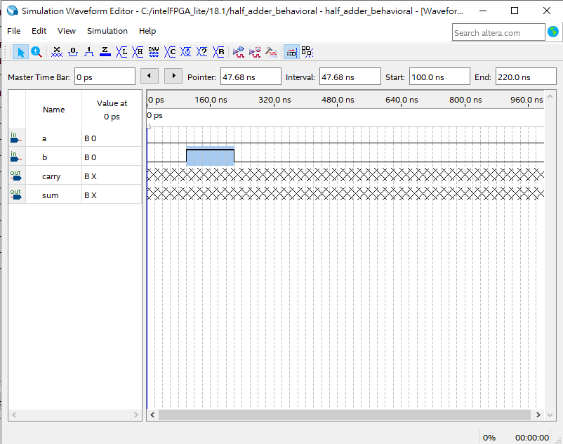
Quartus II Simulation (15/19)
Simulating the Designed Circuit
Select and edit waveform
按住並拖曳即可選取

Slide 25
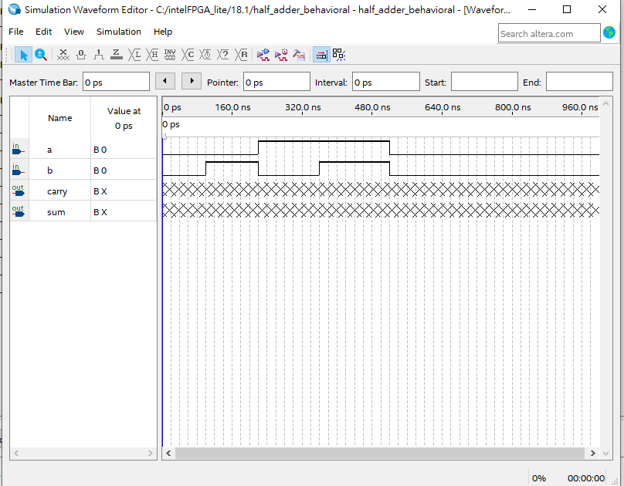
Quartus II Simulation (16/19)
Simulating the Designed Circuit
Setting of test values

Slide 26
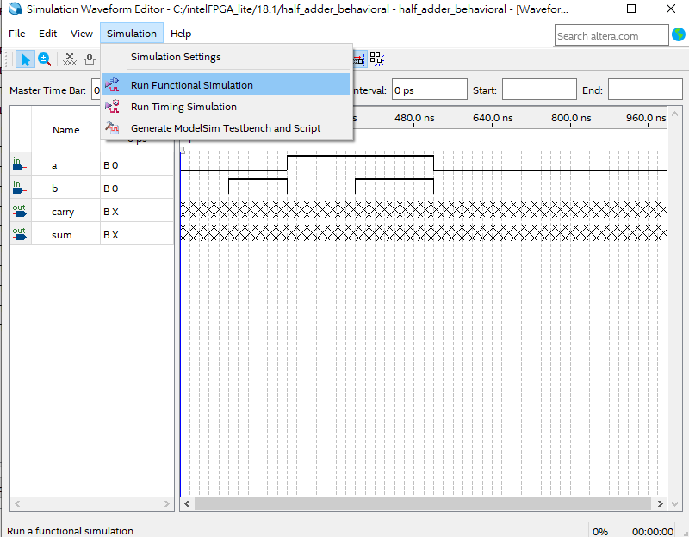
Quartus II Simulation (17/19)
Simulating the Designed Circuit
Run Functional Simulation

Slide 27
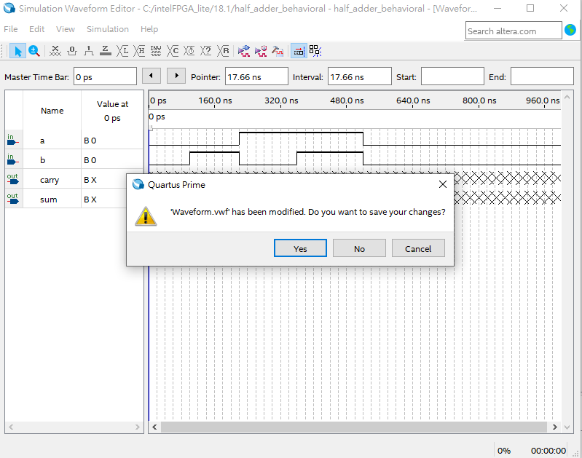
Quartus II Simulation (18/19)
Simulating the Designed Circuit
Save .vwf

Slide 28
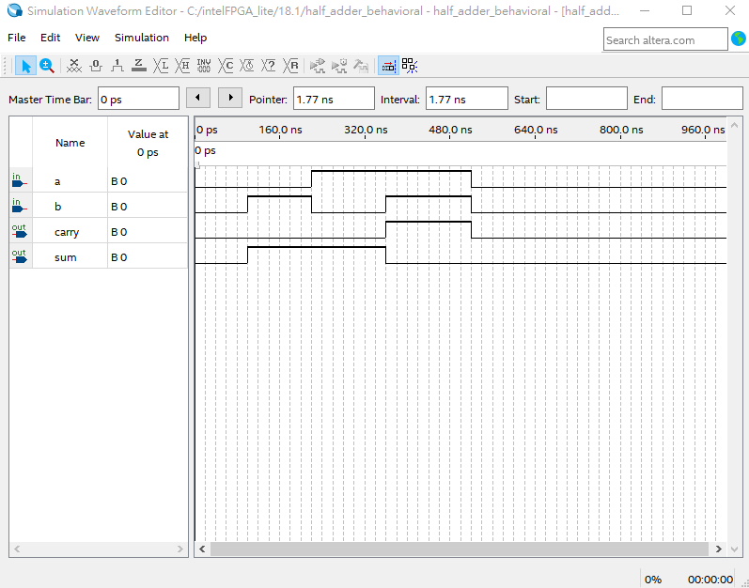
Quartus II Simulation (19/19)
The result of functional simulation
輸入(input) |  | 輸出(output)
被加數(a) | 加數(b) | 和(sum) | 進位(carry)
0 | 0 | 0 | 0
0 | 1 | 1 | 0
1 | 0 | 1 | 0
1 | 1 | 0 | 1

Slide 29
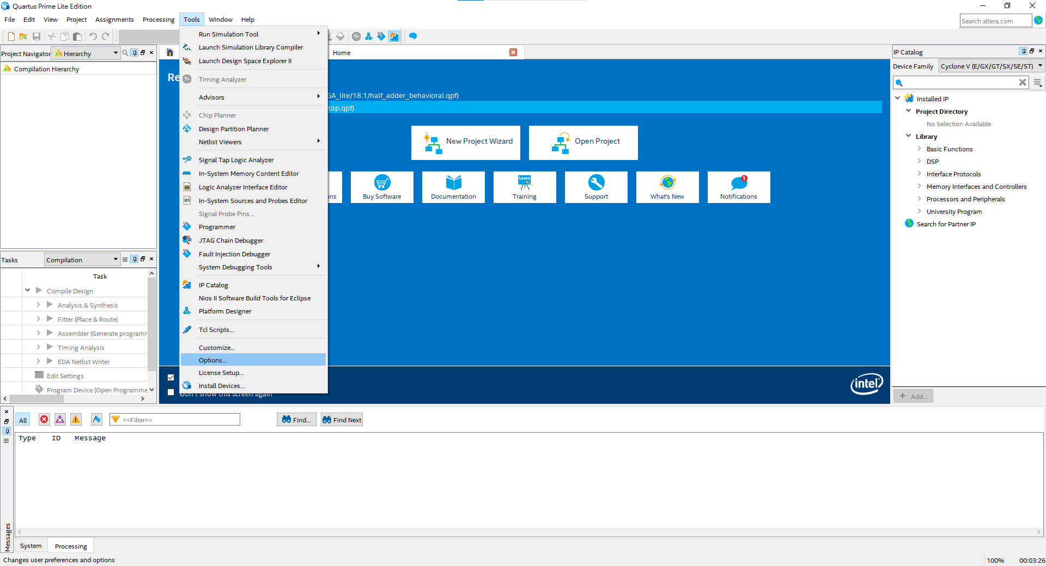
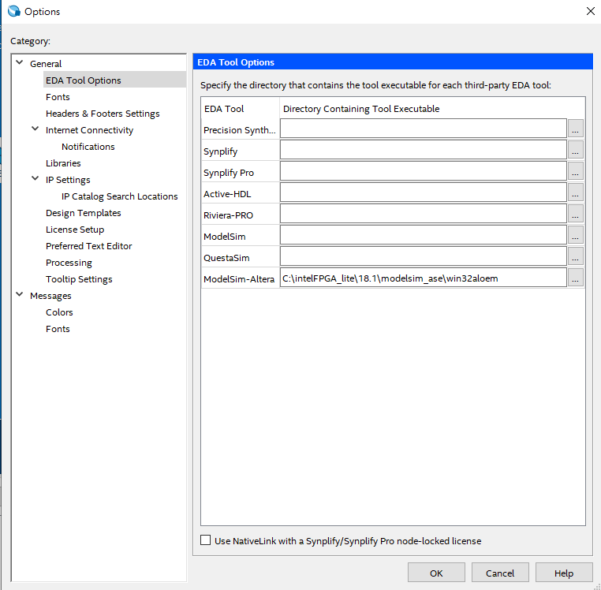
Quartus II Simulation Notice
如果simulation時出現error，修改ModelSim-Altera路徑
個人電腦 : (Tools → Options → EDA Tool Options → ModelSim-Altera → C:\intelFPGA_lite\18.1\modelsim_ase\win32aloem)
實驗室電腦 : (Tools → Options → EDA Tool Options → ModelSim-Altera → C:\intelFPGA\16.1\modelsim_ase\win32aloem)

Slide 30
Lab I - Half Adder
a
sum
xor
01
b
c_out
and
01

Slide 31
Lab I - Half Adder
(a) Using Verilog to implement a 1-bit Half Adder
Please implement with 3 methods
Structural description
Data flow description
Behavioral description
(b) Simulation with waveform

Slide 32
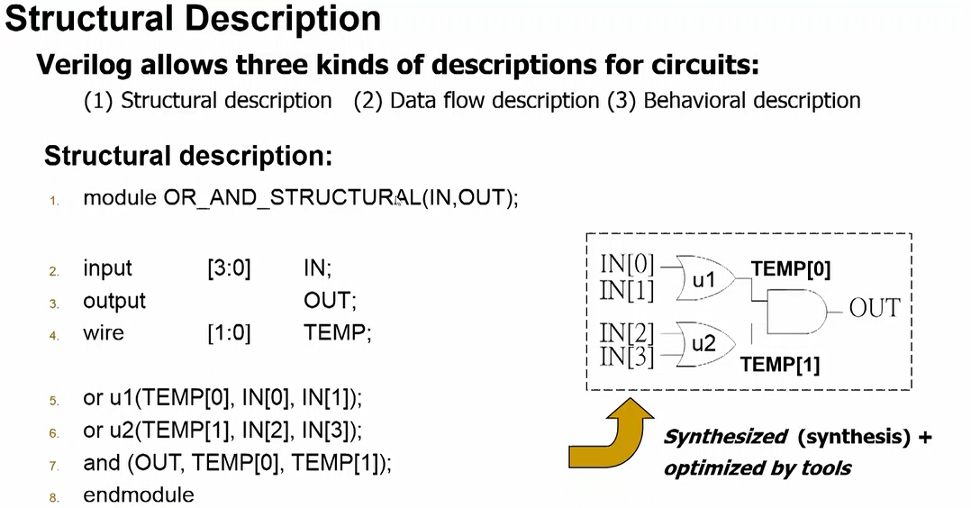
Lab I - Hint

Slide 33
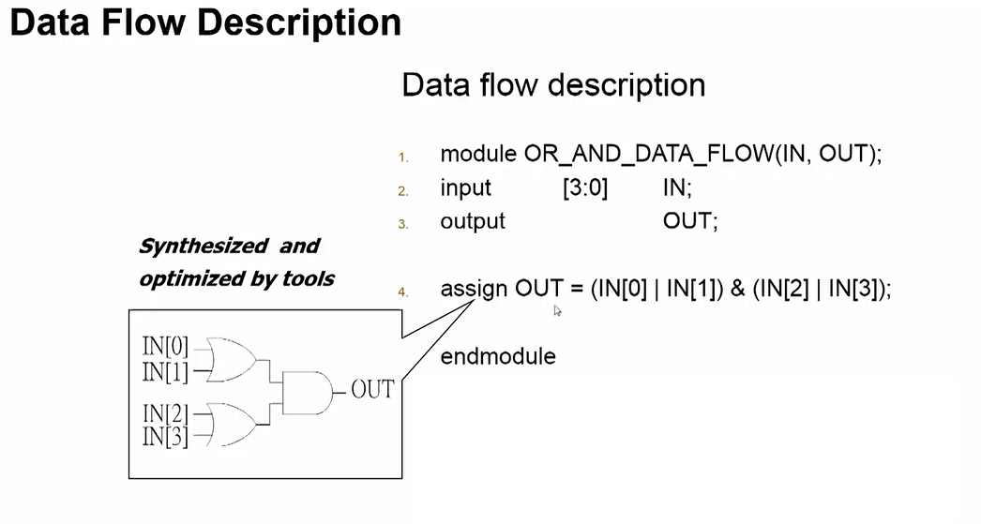
Lab I - Hint

Slide 34
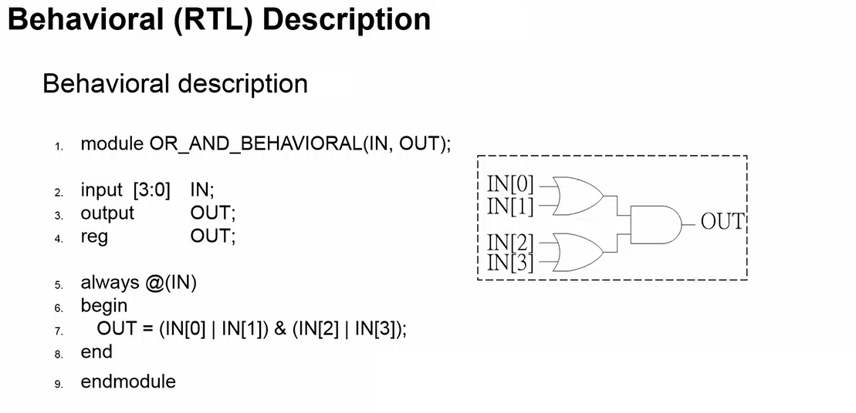
Lab I - Hint

Slide 35
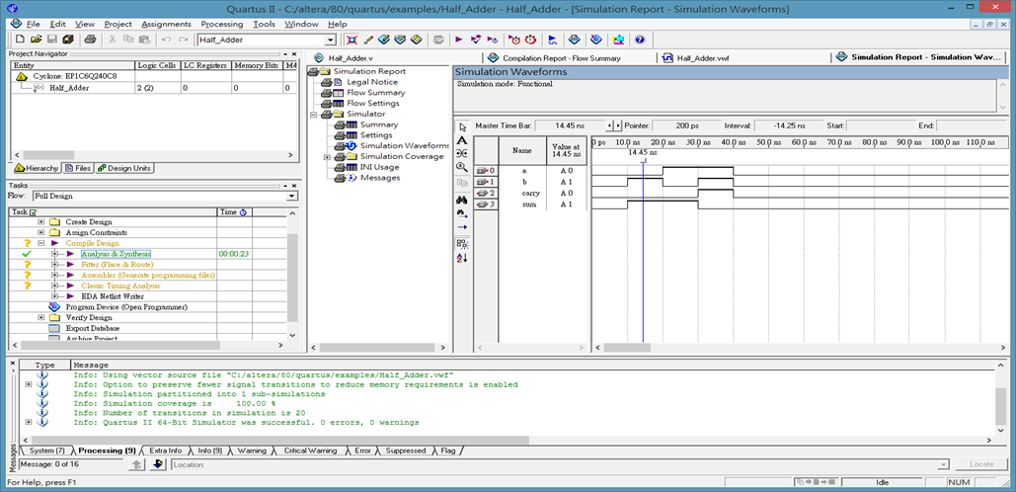
Lab I - Simulation with waveform
a | b | sum | carry
0 | 0 | 0 | 0
0 | 1 | 1 | 0
1 | 0 | 1 | 0
1 | 1 | 0 | 1

Slide 36
Lab II - Full Adder (1/2)

Slide 37
Lab II - Full Adder (2/2)
You can implement a full adder with (2 half adder and 1 or gate).
(a⊕b) ⊕ c_in
c_in
a sum
Add_half
b c_out
sum
(a⊕b) c_in
w1
w3
a
a sum
Add_half
b c_out
c_out
(a⊕b)
M2
b
(a⊕b) c_in + ab
M1
ab
w2

Slide 38
Lab II - Full Adder
(a) Using Verilog to implement a 1-bit Full Adder
Please implement with 3 methods
Structural description(with 2 half adder + 1 or gate)
Data flow description
Behavioral description
(b) Simulation with waveform

Slide 39
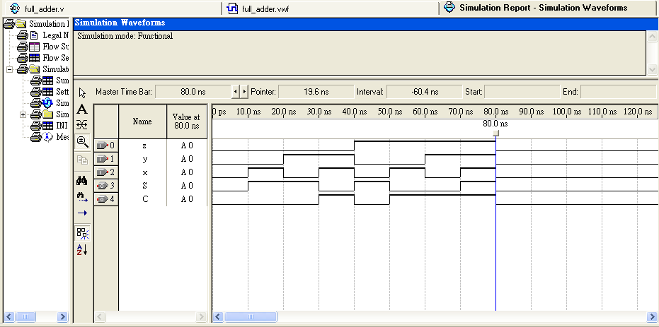
Lab II - Simulation with waveform
z | y | x | S | C
0 | 0 | 0 | 0 | 0
0 | 0 | 1 | 1 | 0
0 | 1 | 0 | 1 | 0
0 | 1 | 1 | 0 | 1
1 | 0 | 0 | 1 | 0
1 | 0 | 1 | 0 | 1
1 | 1 | 0 | 0 | 1
1 | 1 | 1 | 1 | 1

Slide 40
Notice
請勿在桌面建立 Project 及請勿命名中文資料夾
Device family 請確認與 FPGA Chip 符合 (10M50DAF484C7G)
Top module name & Project name 需要一致
確認 module … endmodule 為keyword 變成藍色字體

